Slide 1
How to set up VR for Unreal Engine 5

Slide 2
Before downloading VR software make sure the computer you are using has the correct specs
Check specs here

Slide 3
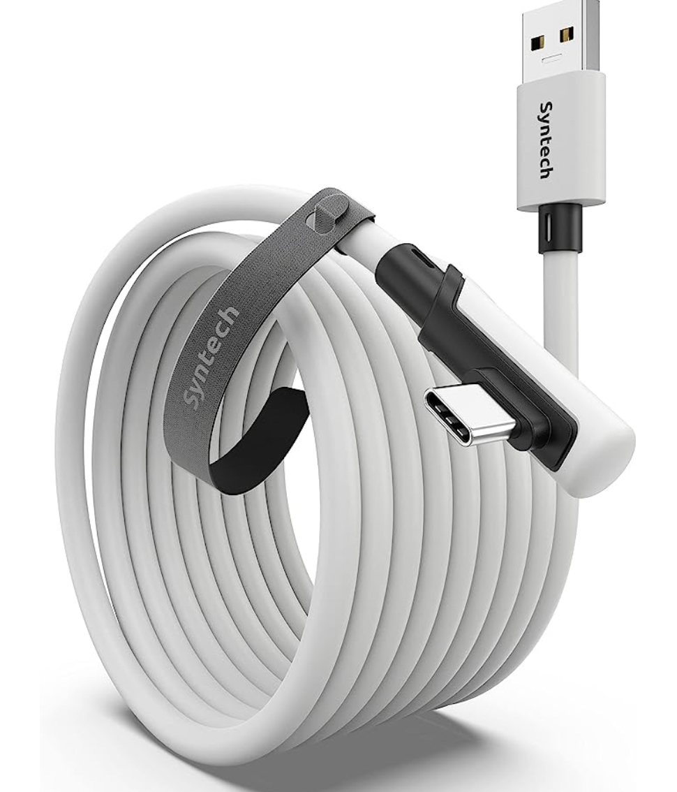
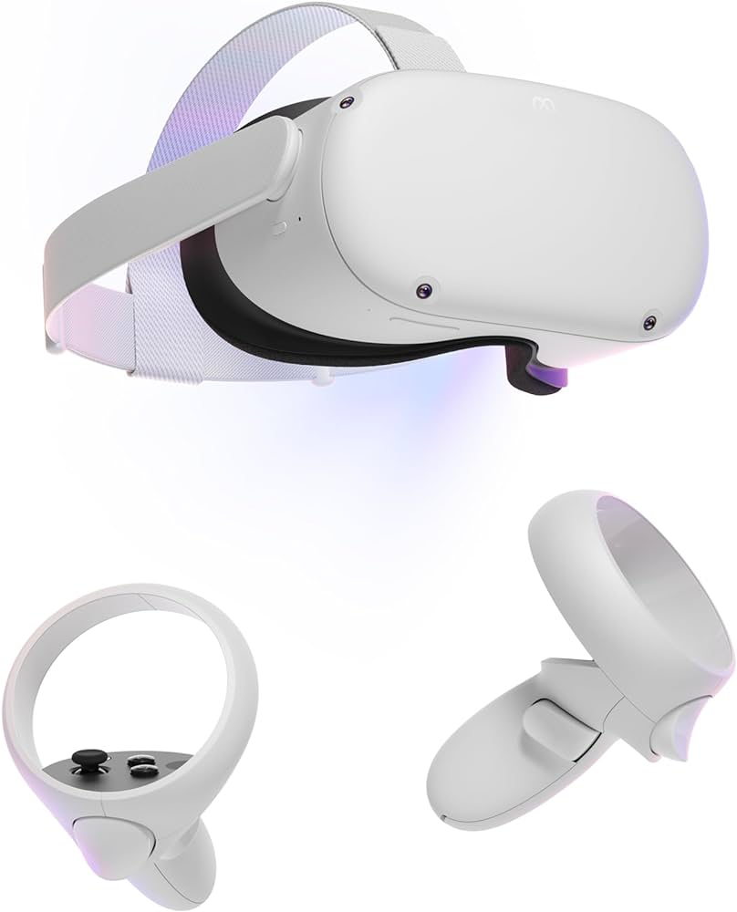
Make sure you have all VR components
First make sure the headset and controllers are charged then check if you have:
Both controllers (left and right)
C to USB data cable (Cannot be regular c to USB cable for charging)
VR headset

Slide 4
Step 1: Make sure your laptop is fully updated and drivers are all updated
Now once everything is download connect the c to USB cable to the head headset to the computer.

Slide 5

Step 2: Download Epic games and make an account
Then open up epic games and download unreal engine. This might be a long process as there will be lots of shaders to download. Once it is done loading open up Unreal Engine.
Unreal Engine Download Link

Slide 6

Step 3: Download Meta on your phone and create an account
Set up your avatar and then turn on the headset. Then in the app pair the headset with your account. There will be a code that pops up on the headset and you would input that into the app.

Slide 7
Step 4: Download Meta Developer Hub
Before logging in make sure to ask someone to add you to the meta developer hub.
Oculus Developer Hub Link

Slide 8

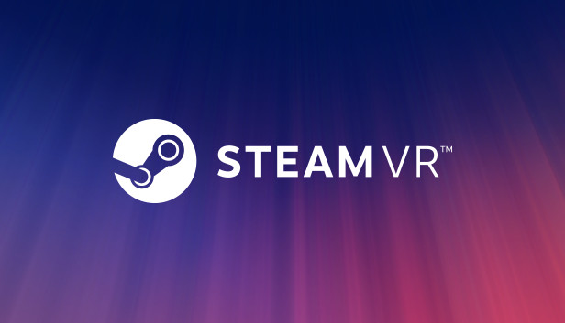
Step 3: Download Steam and create a steam account
Download Steam > search up Steam VR > download Steam VR > launch steam VR.
Steam Download Link

Slide 9
Step 4: Download Oculus Desktop
Once you create another account on this make sure it connects to your headset.
Oculus Desktop Link

Slide 10
Step 5: Close all applications and reopen in this order:
Meta Quest App on your phone (make sure the headset is logged in as you)
Open Steam > launch Steam VR
Open Oculus Desktop
Open Epic Games > launch Unreal Engine

Slide 11
Step 6: Create a Template
When looking through all the categories you should be able to find a VR simulation template go ahead and open that up.
Now whenever you press the play button it will send you into the VR simulation. Don’t forget to save!

